Slide 1
Chapter 4: Threads

Slide 2

Multithreaded Server Architecture

Slide 3
Benefits
Responsiveness – may allow continued execution if part of process is blocked, especially important for user interfaces
Resource Sharing – threads share resources of process, easier than shared memory or message passing
Economy – cheaper than process creation, thread switching lower overhead than context switching
Scalability – Thread can take advantage of multiprocessor architectures

Slide 4
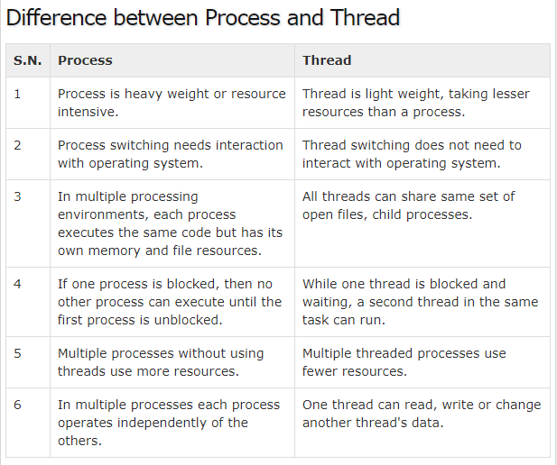


Slide 5
Multicore Programming
Multicore or multiprocessor systems putting pressure on programmers, challenges include:
  Dividing activities
  Balance
  Data splitting
  Data dependency
  Testing and debugging
Parallelism implies a system can perform more than one task simultaneously
Concurrency supports more than one task making progress
  Single processor / core, scheduler providing concurrency

Slide 6


Concurrency vs. Parallelism
Concurrent execution on single-core system:
Parallelism on a multi-core system:

Slide 7
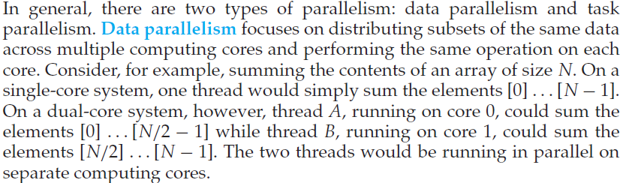
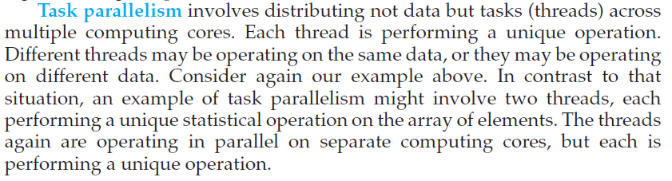
Types of Parallelism

Slide 8

Single and Multithreaded Processes

Slide 9
User Threads and Kernel Threads
Support for threads may be provided either at the user level, for user threads, or by the kernel, for kernel threads.
User threads –
  the thread management kernel is not aware of the existence of threads. The thread library contains code for creating and destroying threads, for passing message and data between threads, for scheduling thread execution and for saving and restoring thread contexts. The application starts with a single thread. management done by user-level threads library
Three primary thread libraries:
  POSIX Pthreads
  Windows threads
  Java threads

Slide 10
User Threads and Kernel Threads
Kernel threads - thread management is done by the Kernel. There is no thread management code in the application area. Kernel threads are supported directly by the operating system.
The Kernel maintains context information for the process as a whole and for individuals threads within the process. Scheduling by the Kernel is done on a thread basis. The Kernel performs thread creation, scheduling and management in Kernel space. Kernel threads are generally slower to create and manage than the user threads.
Examples – virtually all general purpose operating systems, including:
  Windows
  Solaris
  Linux
  Tru64 UNIX
  Mac OS X

Slide 11
A user-level thread library has a number of advantages.
  First, it is cheap to create and destroy threads. Because all thread administration is kept in the user's address space, the price of creating a thread is primarily determined by the cost for allocating memory to set up a thread stack
  second advantage of user-level threads is that switching thread context can often be done in just a few instructions. Basically, only the values of the CPU registers need to be stored and subsequently reloaded with the previously stored values of the thread to which it is being switched. There is no need to change memory maps, flush the TLB, do CPU accounting, and so on
A major drawback of user-level threads is
  that invocation of a blocking system call will immediately block the entire process to which the thread belongs, and thus also all the other threads in that process.

Slide 12
These problems can be mostly circumvented by implementing threads in the operating system's kernel. Unfortunately, there is a high price to pay: every thread operation (creation, deletion, synchronization, etc.), will have to be carried out by the kernel requiring a system call.
A solution lies in a hybrid form of user-level and kernel-level threads, generally referred to as lightweight processes (LWP).
An LWP runs in the context of a single (heavy-weight) process, and there can be several LWPs per process. In addition to having LWPs, a system also offers a user-level thread package.
Offering applications the usual operations for creating and destroying threads. In addition, the package provides facilities for thread synchronization. such as mutexes and condition variables. The important issue is that the thread package is implemented entirely in user space. In other words. all operations on threads are carried out without intervention of the kernel.
The thread package can be shared by multiple LWPs, as shown in Fig. 3-2. This means that each LWP can be running its own (user-level) thread.
Multithreaded applications are constructed by creating threads, and subsequently assigning each thread to an LWP. Assigning a thread to an LWP is normally implicit and hidden from the programmer.

Slide 13
The combination of (user-level) threads and LWPs works as follows:
  The thread package has a single routine to schedule the next thread.
  When creating an LWP (which is done by means of a system call), the LWP is given its own stack, and is instructed to execute the scheduling routine in search of a thread to execute.
  If there are several LWPs, then each of them executes the scheduler. The thread table, which is used to keep track of the current set of threads, is thus shared by the LWPs.
  Protecting this table to guarantee mutually exclusive access is done by means of mutexes that are implemented entirely in user space. In other words, synchronization between LWPs does not require any kernel support.
  When an LWP finds a runnable thread, it switches context to that thread. Meanwhile, other LWPs may be looking for other runnable threads as well.

Slide 14
when a thread does a blocking system call the execution changes from user mode to kernel mode. but still continues in the context of the current LWP.
At the point where the current LWP can no longer continue, the operating system may decide to switch context to another LWP, which also implies that a context switch is made back to user mode. The selected LWP will simply continue where it had previously left off.

Slide 15
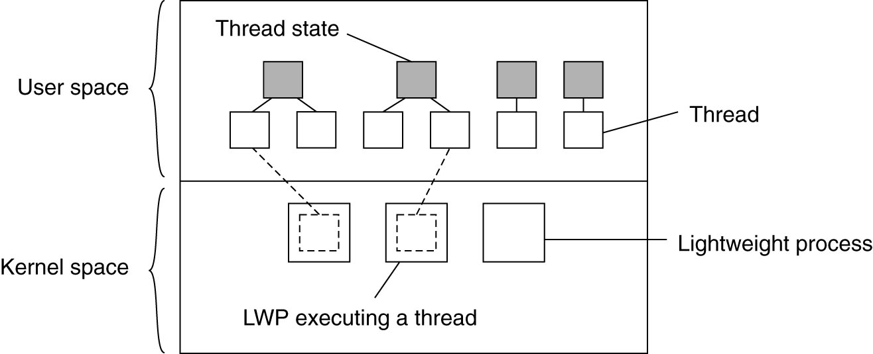
Thread Implementation
Figure 3-2. Combining kernel-level lightweight
processes and user-level threads.

Slide 16
Multithreading Models
Many-to-One
One-to-One
Many-to-Many

Slide 17

Many-to-One
Many user-level threads mapped to single kernel thread
Thread management is done by the thread library in user space, so it is efficient.
One thread blocking causes all to block
Multiple threads may not run in parallel on muticore system because only one may be in kernel at a time
Few systems currently use this model
Examples:
  Solaris Green Threads
  GNU Portable Threads

Slide 18

One-to-One
Each user-level thread maps to kernel thread
More concurrency than many-to-one
Allows multiple threads to run in multiprocessor
Creating a user-level thread creates a kernel thread
Number of threads per process sometimes restricted due to overhead
Examples
  Windows
  Linux
  Solaris 9 and later

Slide 19

Many-to-Many Model
Allows many user level threads to be mapped to many kernel threads
Multiplexes many user threads to a smaller or equal number of kernel threads
Number of kernel threads may be specific to either a particular application of particular machine.
Developers can create as many user threads as necessary and corresponding kernel threads can run in parallel in a multiprocessor
When a thread performs a blocking system call the kernel can schedule another thread for execution.
Solaris prior to version 9
Windows with the ThreadFiber package

Slide 20

Two-level Model
Similar to M:M, except that it allows a user thread to be bound to kernel thread
Examples
  IRIX
  HP-UX
  Tru64 UNIX
  Solaris 8 and earlier

Slide 21
End of Chapter 4

